Slide 1
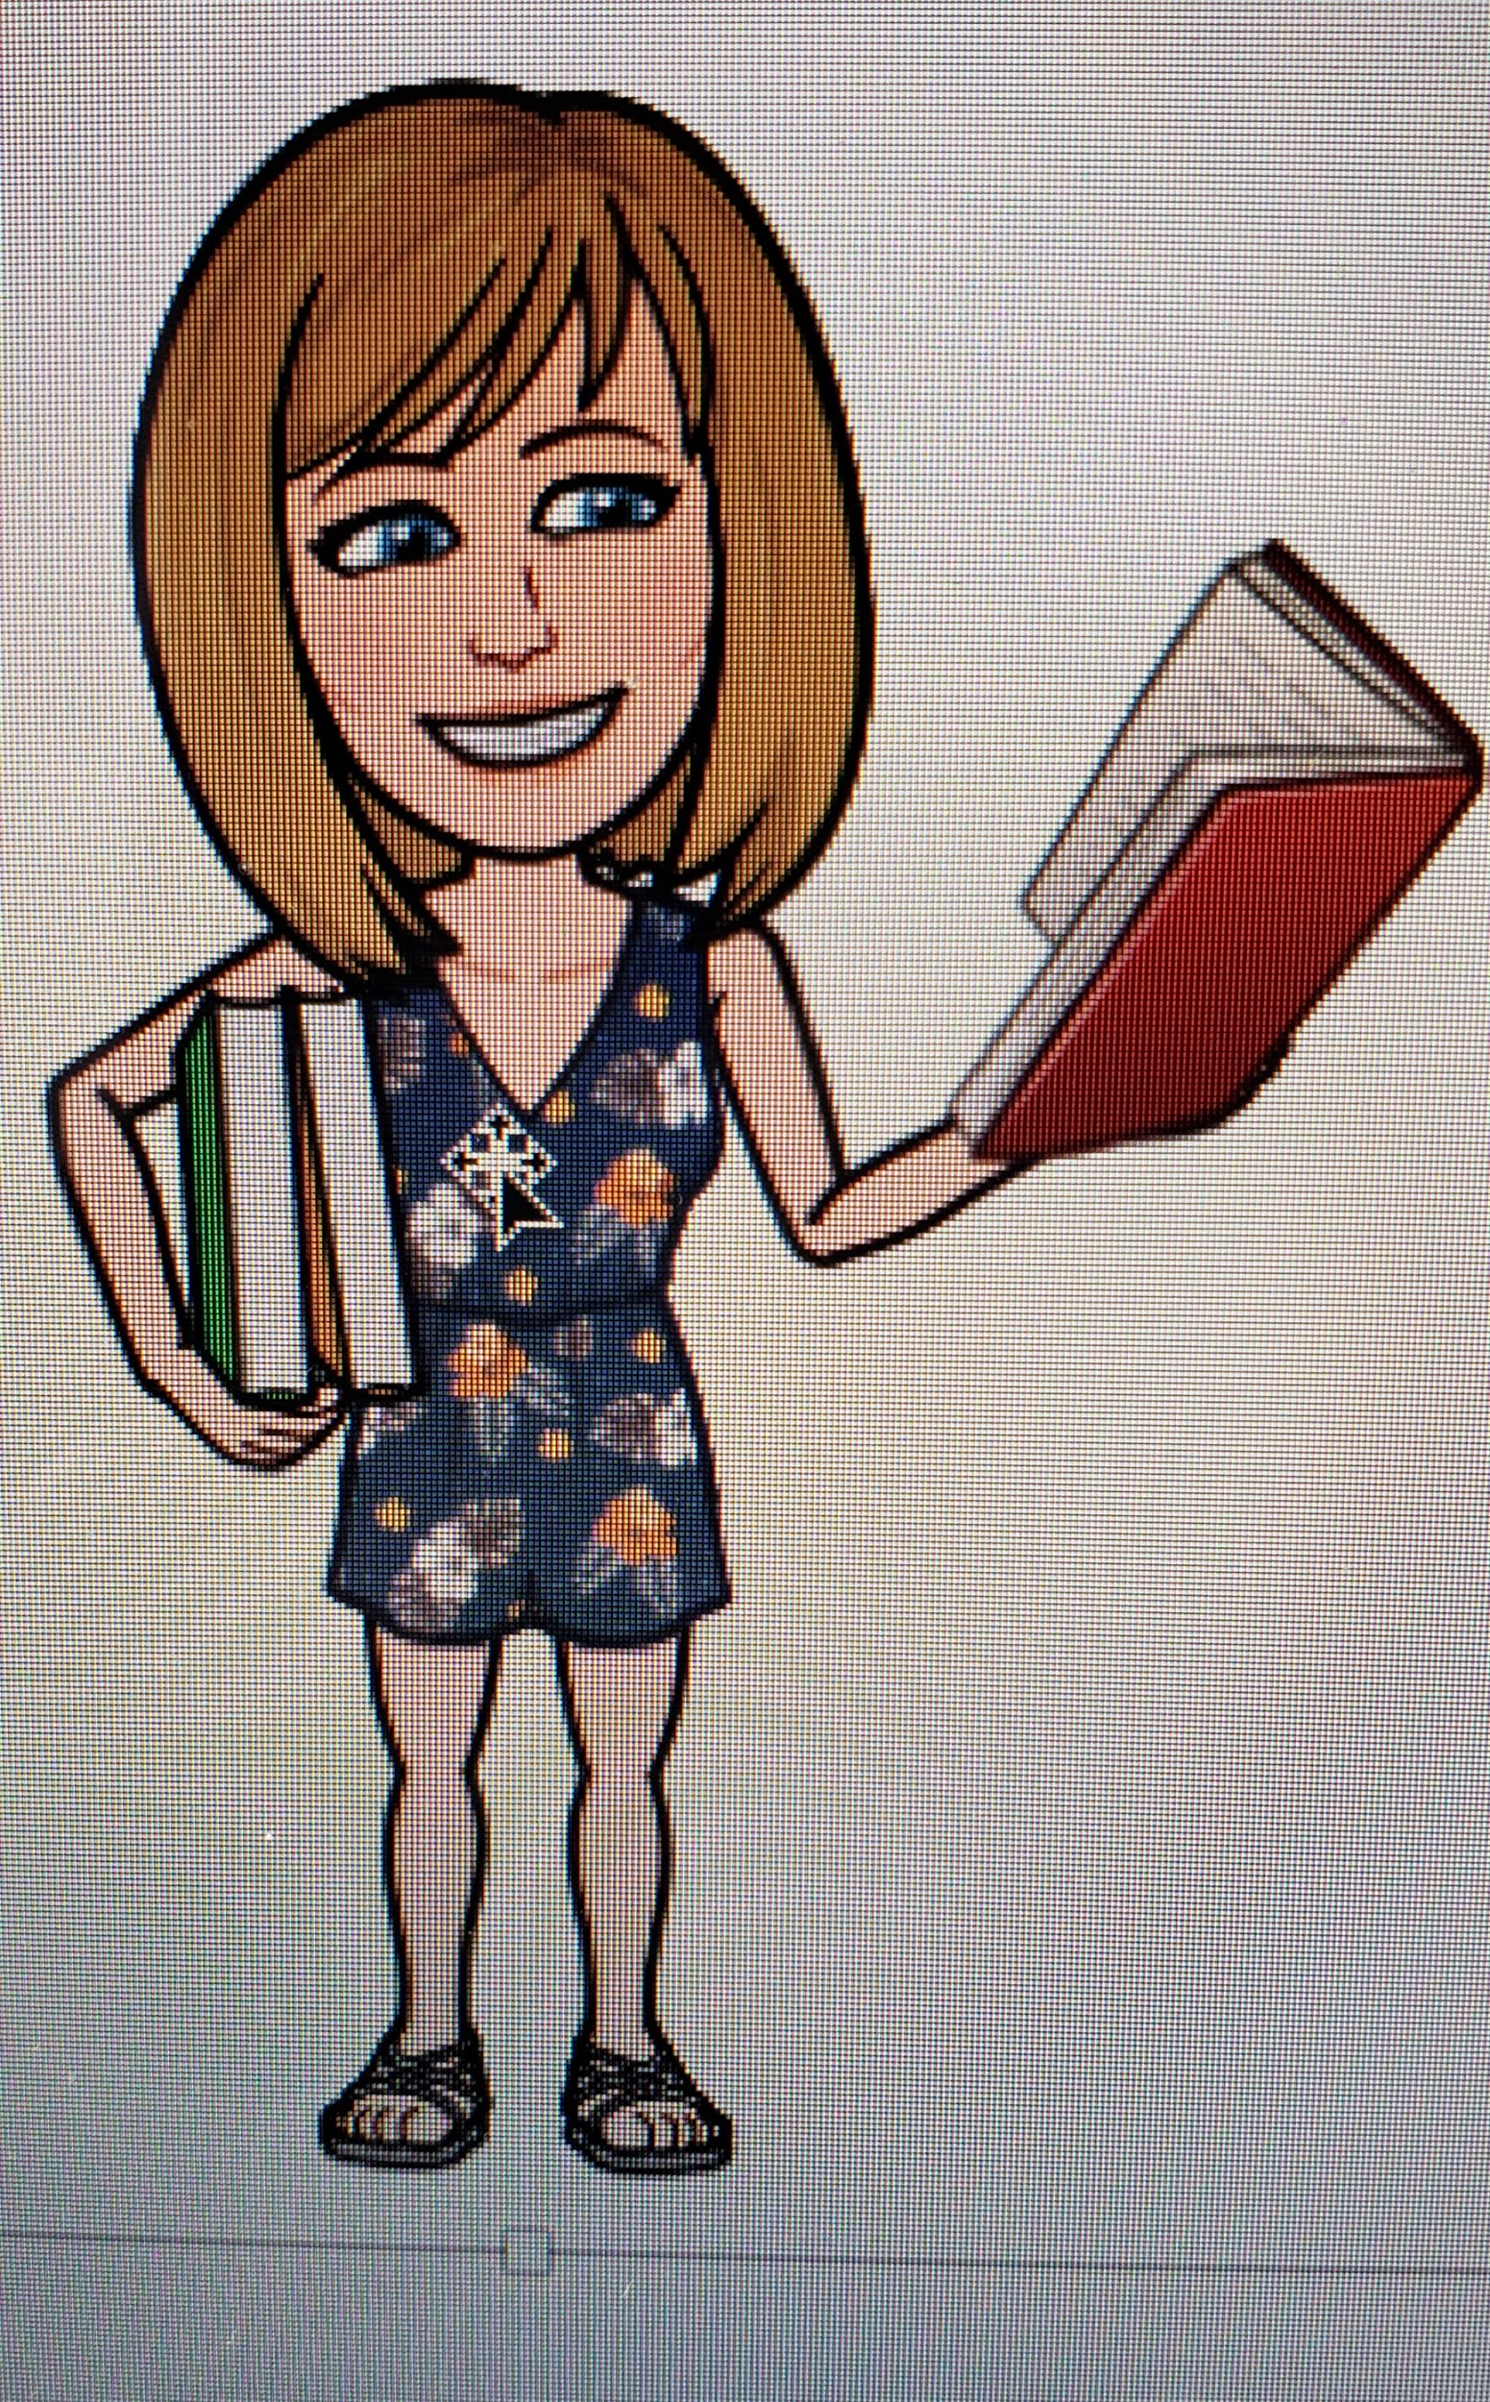
Welcome to Government, Economics, and Resource with Mrs. Brodfuehrer!
I teach with Mr. Rice.
We look forward
to teaching your kids.

Slide 2
Stay
Connected
About Mrs. Brodfuehrer
Syllabus
In class & remote expectations
COVID 19 Information
Our Bell Schedule

Slide 3
Amy Brodfuehrer
abrodfuehrer@frontiercsd.org
Frank Rice
frice@frontiercsd.org
School Website: https://www.frontiercsd.org
District website~
Check the HS and District pages frequently

Slide 4
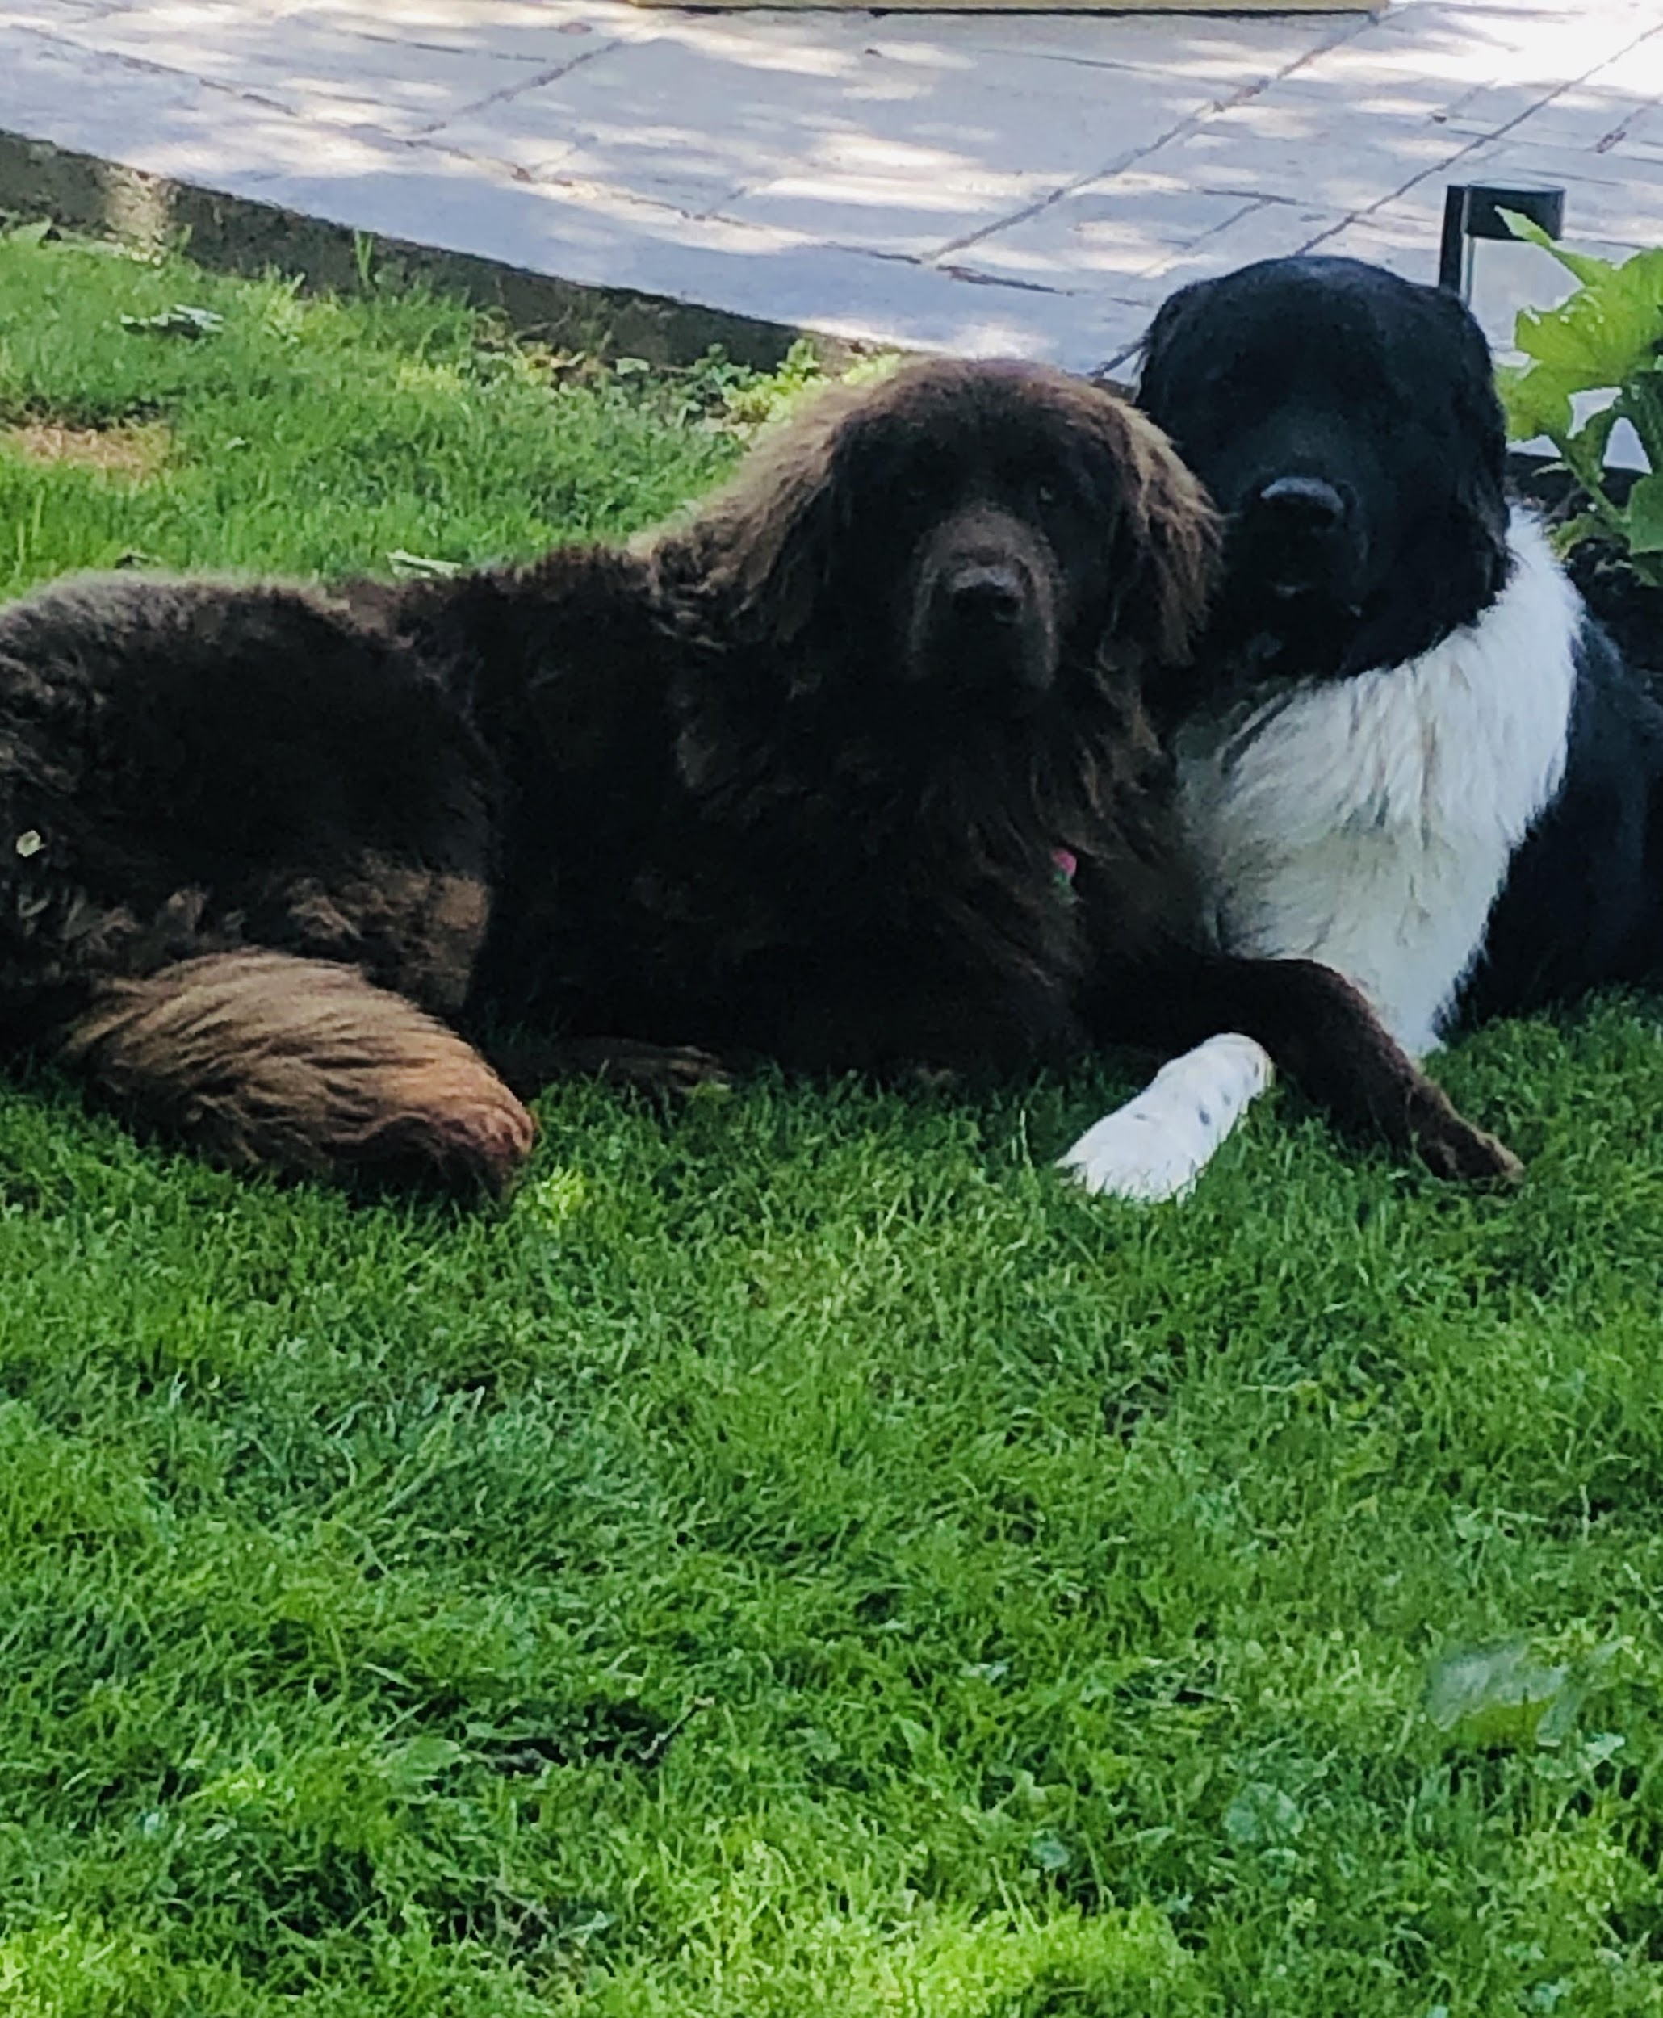
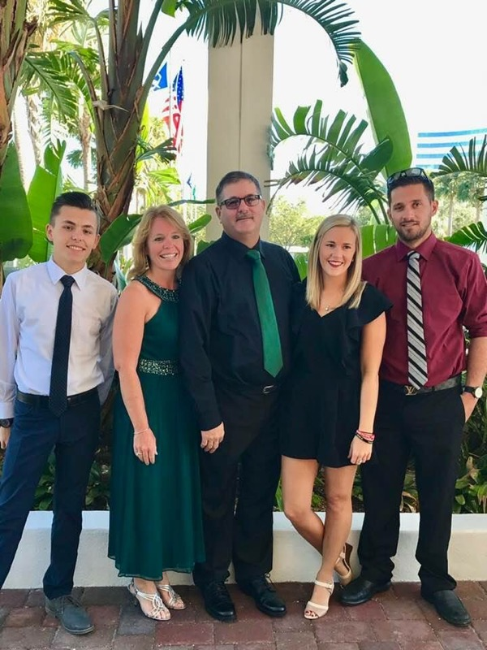
Hi! I’m Mrs. Brodfuehrer
I know there are many questions at the start of this new year and many of them may
never get answers, but I promise that I will work hard to help your child in our classroom.
Mr. Rice and I have
been co-teaching together for many years at Frontier and we are here for your child.
I am a mom of three young adults. My oldest step-son Matthew is 31. He is a landscaper. My step-daughter Caitlin is 28, recently engaged and is attending nursing school. My youngest Nicholas is 20, and he is a Junior at Merchyhurst University in the Intelligence Studies Program. My husband, David is a 911 dispatcher and we both have been volunteer firefighters since we graduated high school. I have 2 Newfoundland dogs which take up much of my time and are nothing but big cuddle bugs!
This year I will promise that your child will not fail our class unless they do nothing. Any student
that tries his/her best and is willing to work hard will be successful. I look forward to working with
your child and will go above and beyond to help them as long as they are putting the
effort in too. Our goal is to teach your child to be better citizens, financially responsible, and to become independent young adults. Encourage your child to advocate for themselves and to come talk to either of us if they are confused or uncertain about what they should be doing.
I can be reached via email at abrodfuehrer@frontiercsd.org
.

Slide 5
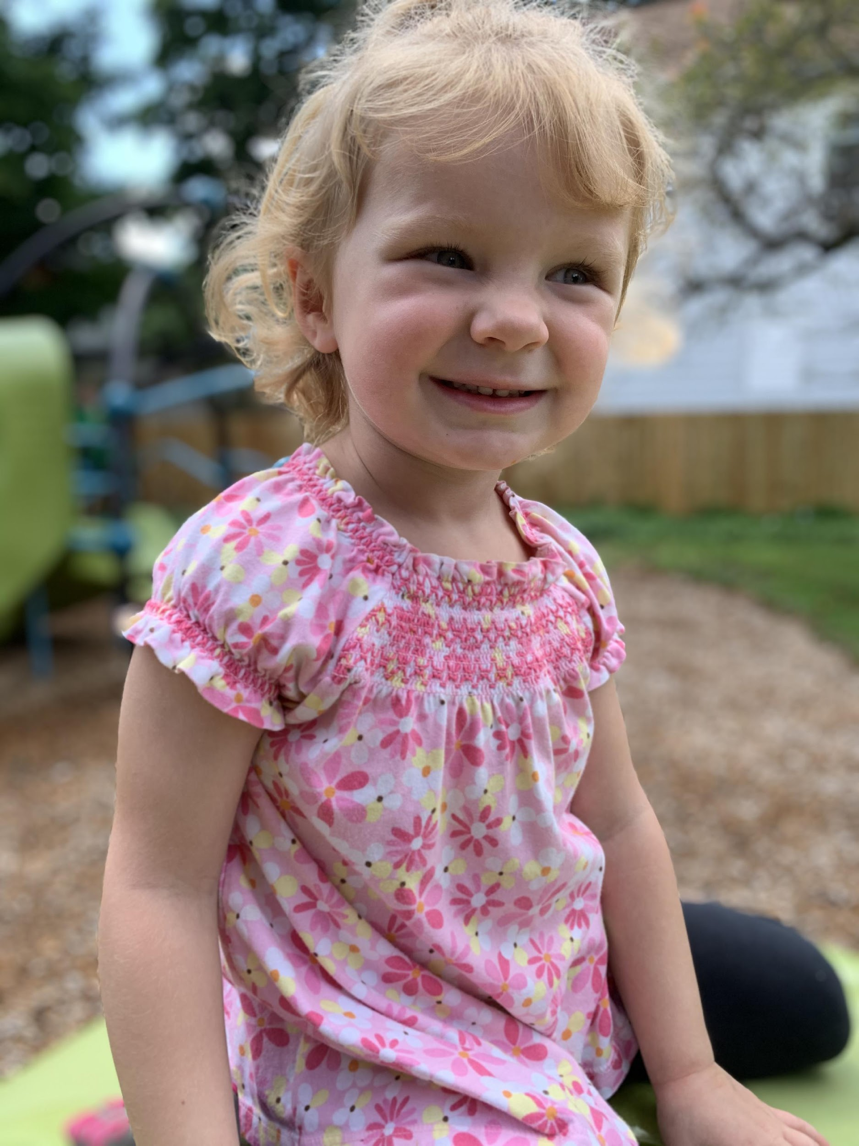
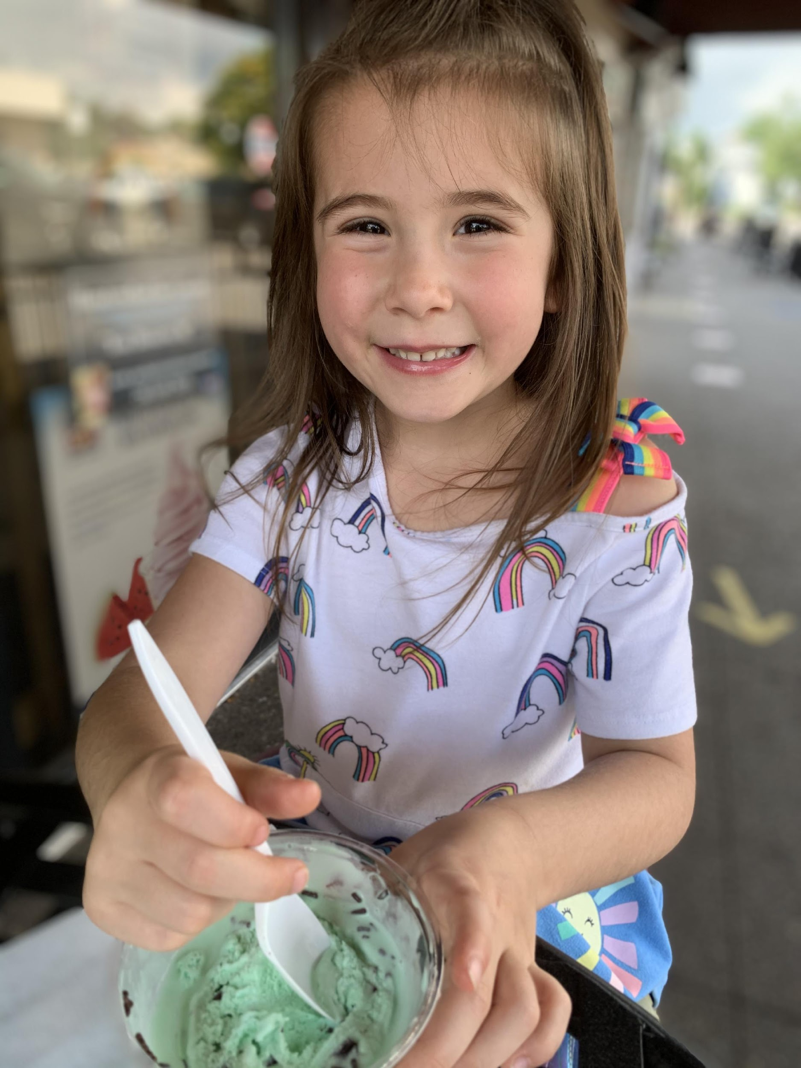
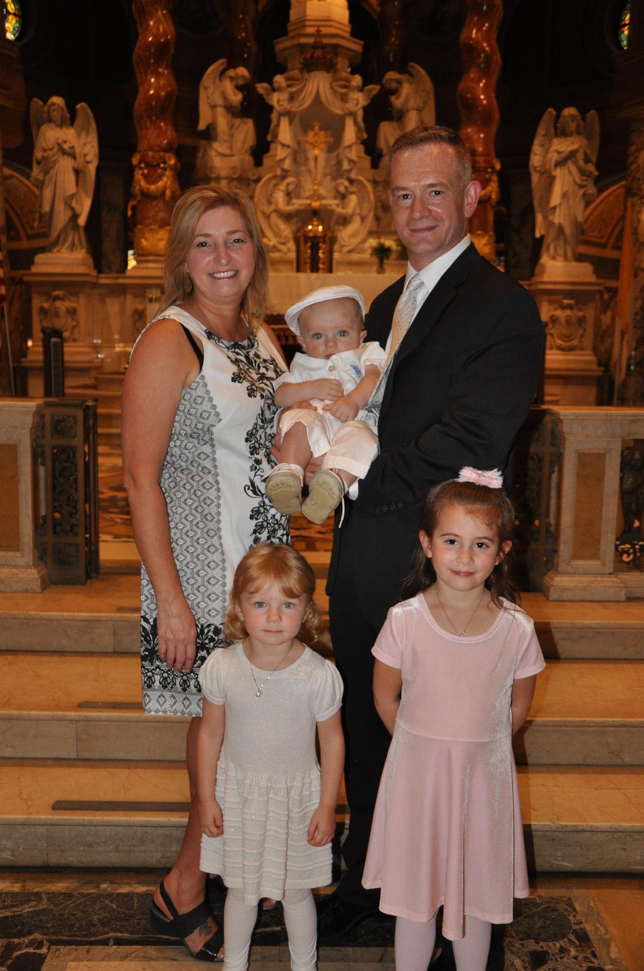
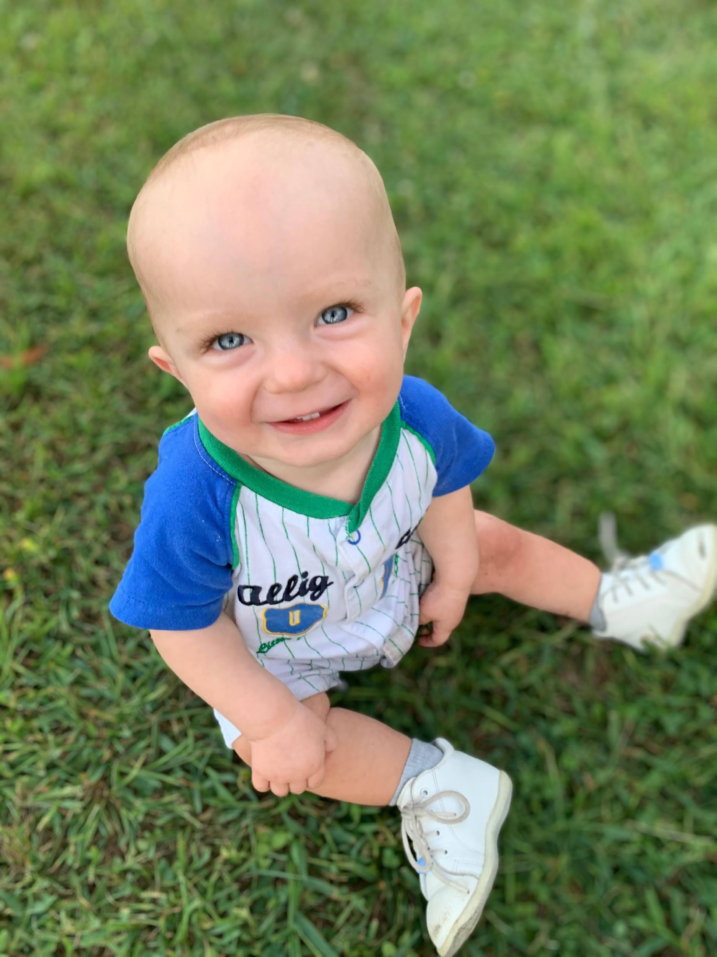
…And I am Mr. Rice
“Out of adversity comes opportunity”
Benjamin Franklin’s observation is certainly true when it comes to the start
of the 2020 school year! While this year will be challenging, it gives your child
the chance to learn in new ways and to become more independent and responsible.
Mrs. Brodfuehrer and I tailor our classes to be based in theory, but then to apply
those theories to the real world.
I have been teaching for 26 years and have been co-teaching with Mrs. Brodfuehrer for over 10.
At home, I have an amazing wife and two daughters ages 6 and 3 and a soon-to-be 1 year old son.
Martial arts have always been a core part of life for me and I love standup paddle boarding.
I always tell students that to be successful in my class, they need to do 3 things.
Be Responsible
Be Respectful
Be Honest
Following these rules will bring them excellence in my class, as well as in life.
I can be reached via email at frice@frontiercsd.org
.

Slide 6
Govt/Eco/Resource Room
Syllabus can be found
in your child’s Google Classroom or please visit my webpage on the Frontier High school website.

Slide 7
Virtual students & Remote Learning Days
100% VIRTUAL
Government: Complete work in Google Classroom and check announcements. You are to report LIVE during your scheduled class period.
ECO: Follow directions from Mrs Schober as she has been assigned your instructor.
Remote Days for Hybrid: Work will be posted in classroom. No matter what, check in through Google Classroom and for attendance, you need to complete any work/check-in by 12:00 pm.
EVERYONE MUST CHECK-IN ON WEDNESDAYS By 12pm
*students will be expected to come to class prepared and ready to learn. With the abbreviated schedule we have, it will be vital to get down to work as soon as possible.
Hybrid instruction
Gov: Check Google Classroom and complete work at your own pace. You have one week to complete it unless otherwise noted.
Eco: LIVE DAILY (except Wed). Log in during class time.
Together we will get into a routine and make our time together productive.

Slide 8
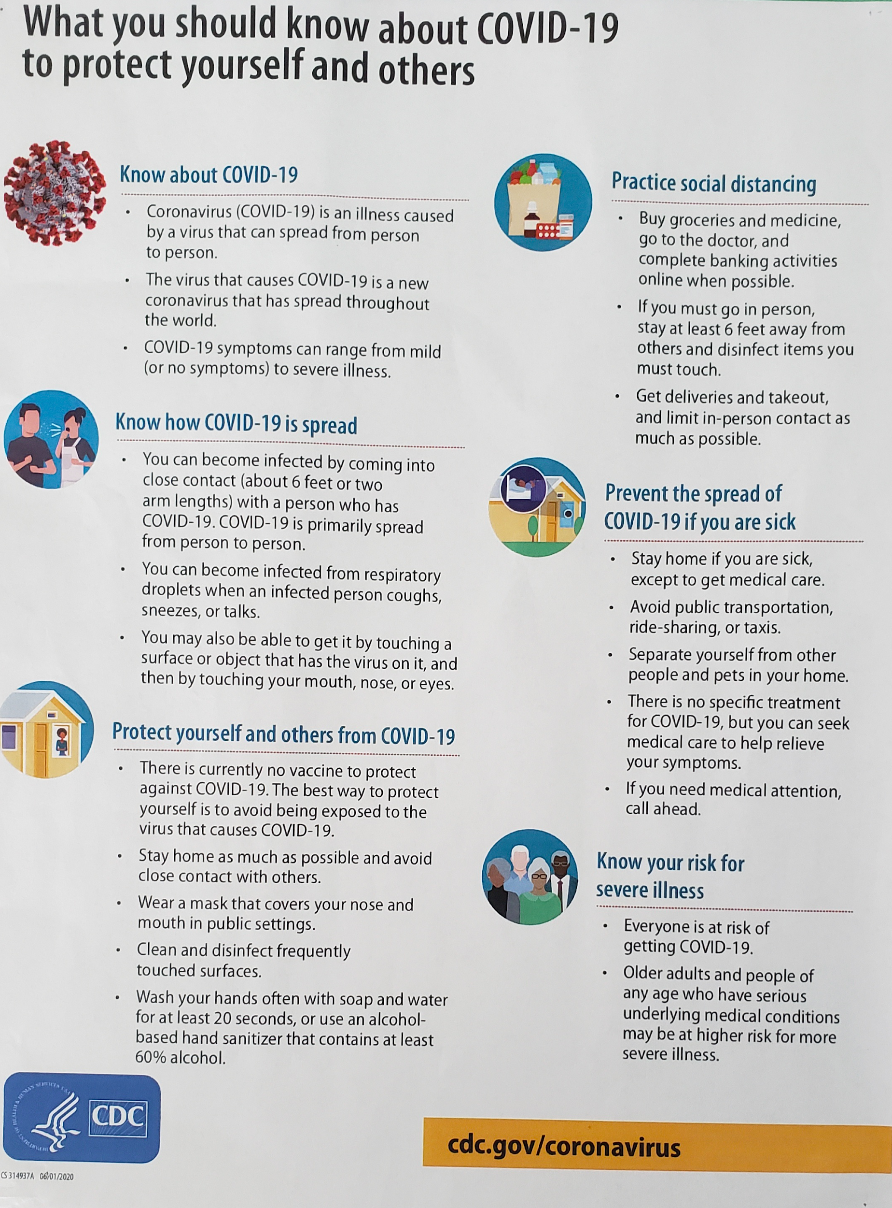

Slide 9
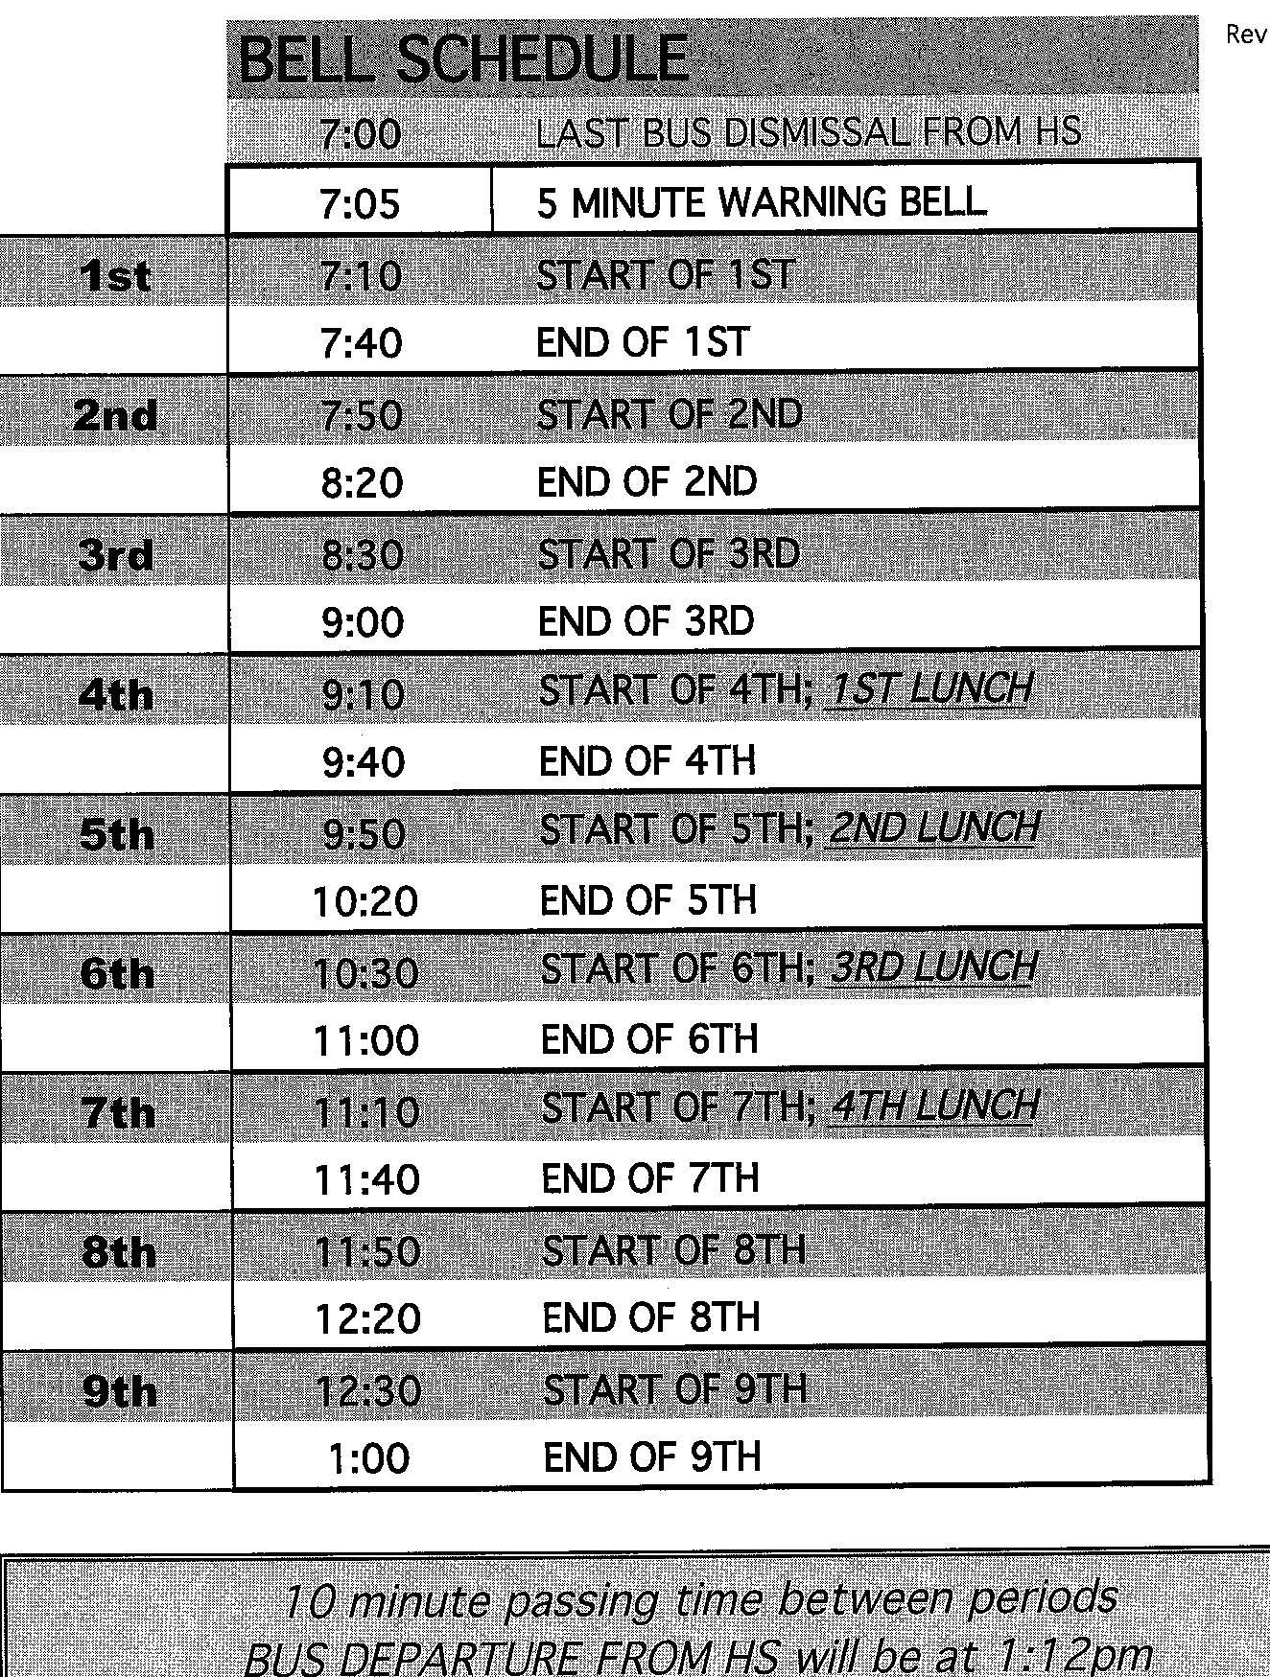
Students will be dismissed at 1 pm. There are no late buses at this time. Your student must be with a teacher if he/she is staying after and will need to find transportation home.

Slide 10
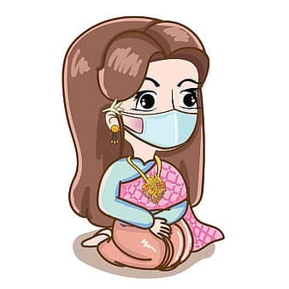
2020 Classroom Rules & Expectations
Economics is live stream and Cohort A and B must be live with us during the assigned class period. All Virtual have been assigned to Mrs. Schober.
Government work is prepared for the week to allow students to pace themselves and it is due each Sunday by noon. Any specific due dates will be announced in class and on GC with plenty of time to prepare.
ALL students much check in on WEDNESDAY by noon through classroom.
Resource Room students check in DAILY through classroom by noon.
*No food or drinks in the classroom. No exceptions.
*No bathroom breaks unless it is an emergency. You will be escorted by a hall monitor. Use the 10- minute passing time.
* No phone use unless we invite you to use it, which we will do often. If we are not using them, please place your phone in your backpack or under your desk.
*You must check your google classroom daily regardless if you are in class or home.

